Slide 1
Homework 3 – Controller design
Yi Chen
3/1/2020

Slide 2
Overview
PPC
System setup
System response
Frequency response
LQG
MRC

Slide 3
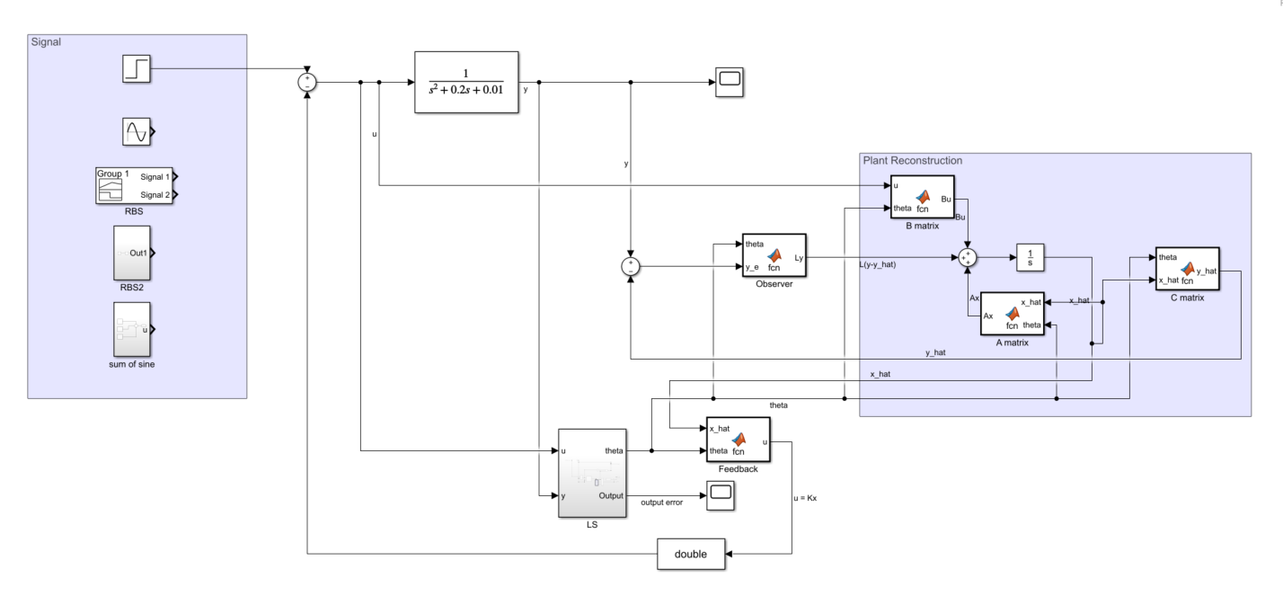
PPC - setup

Slide 4
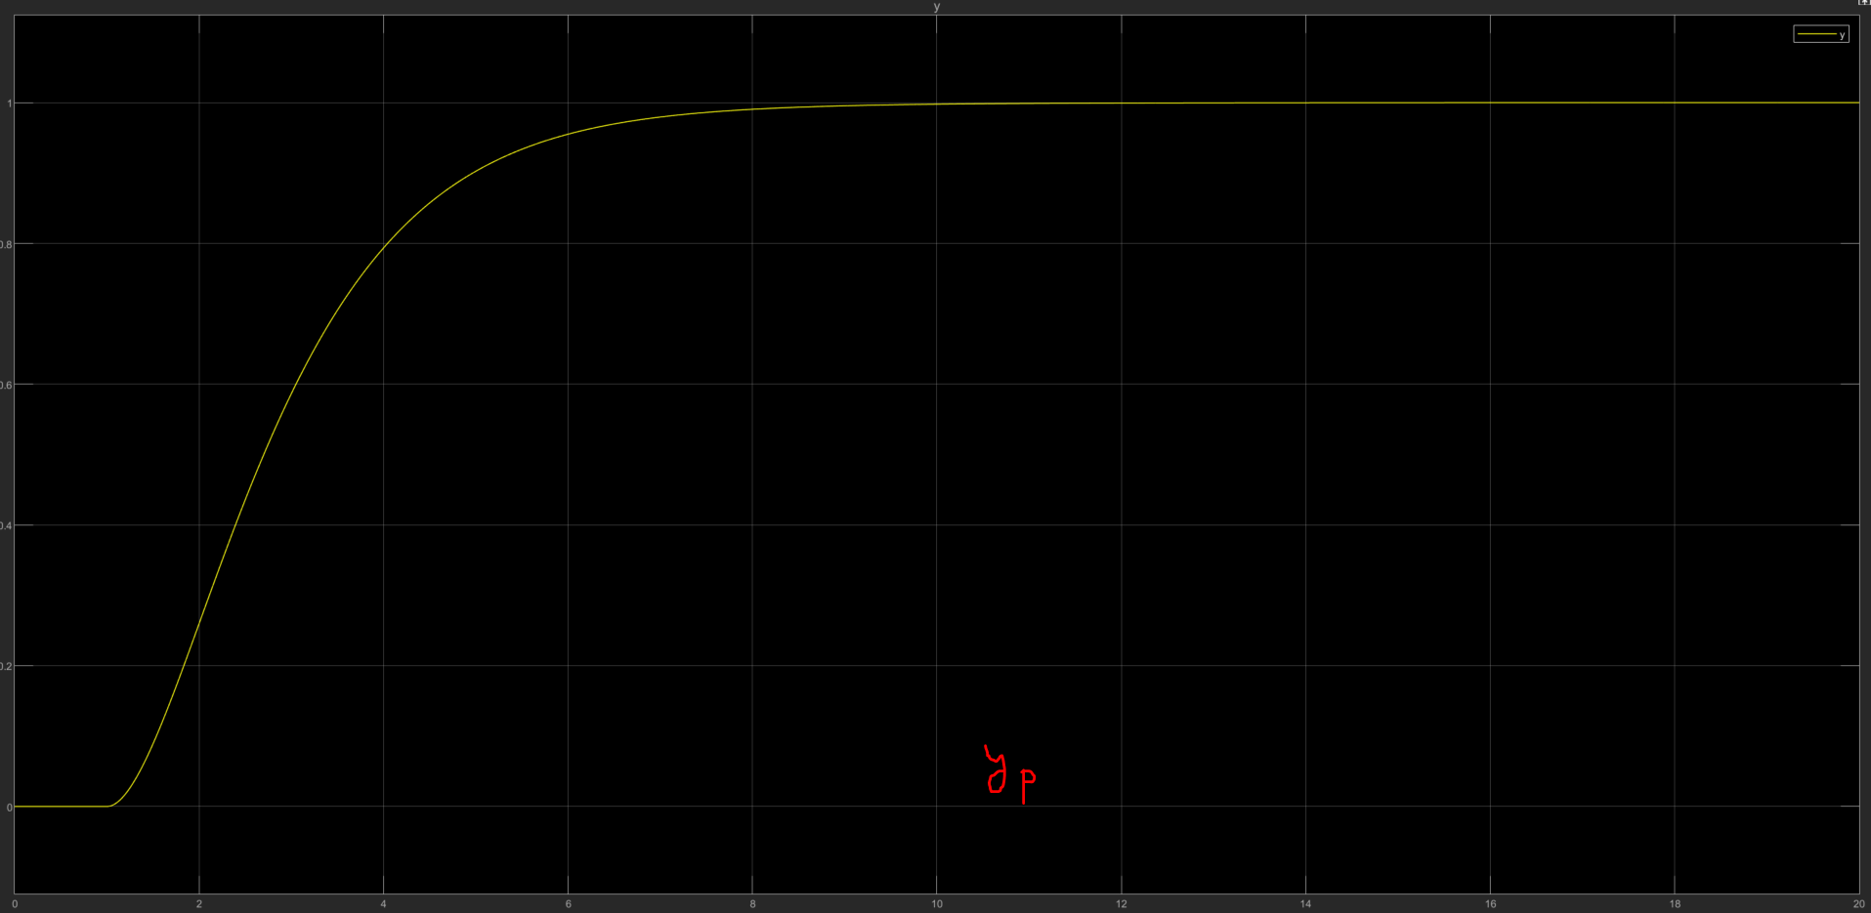
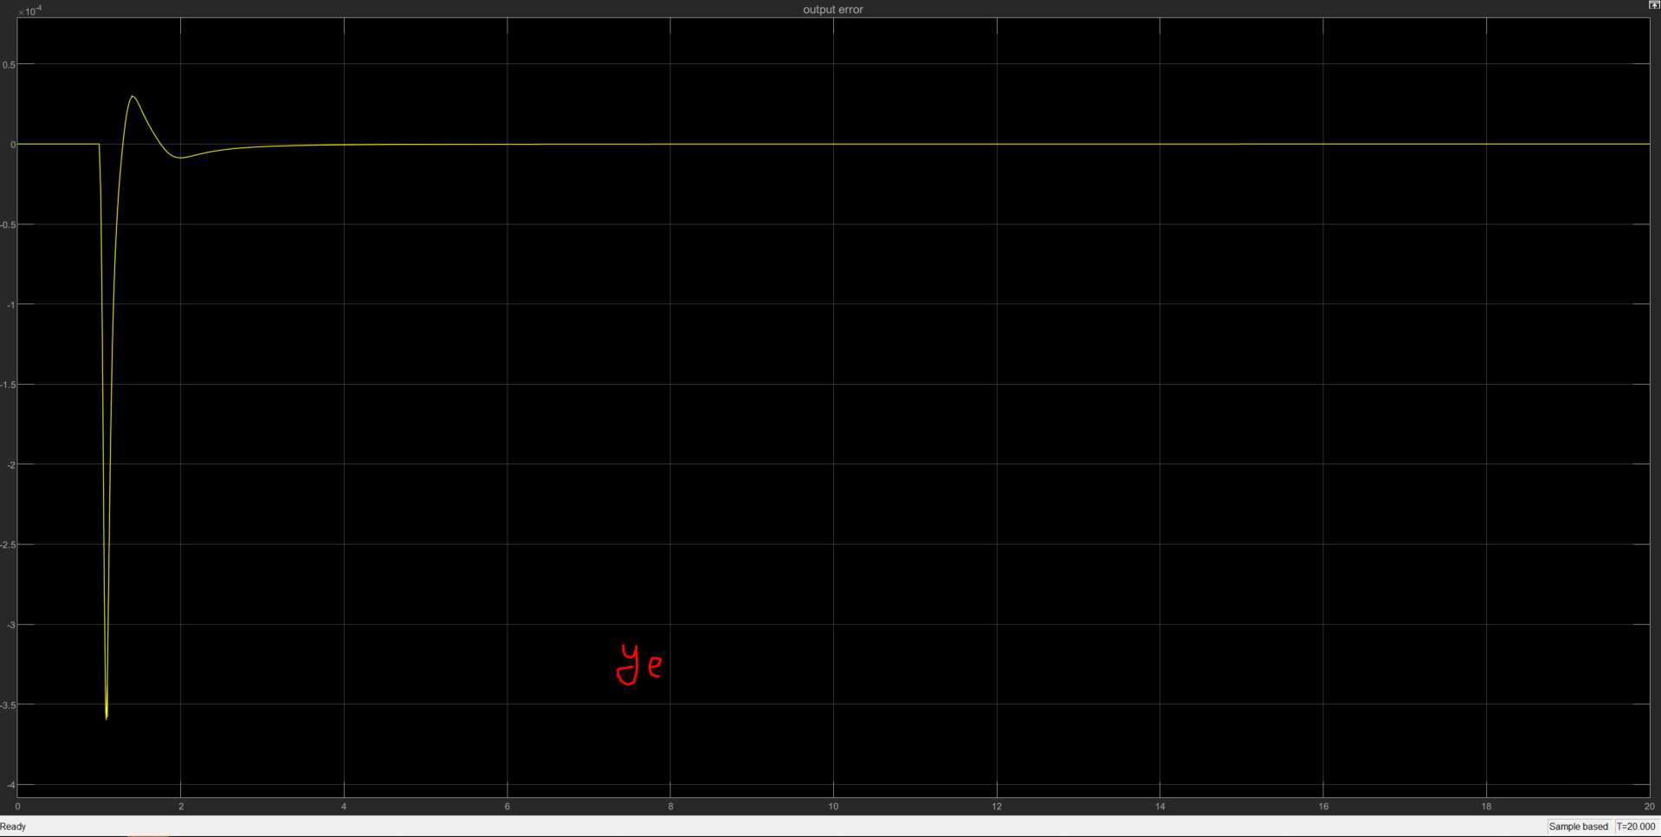
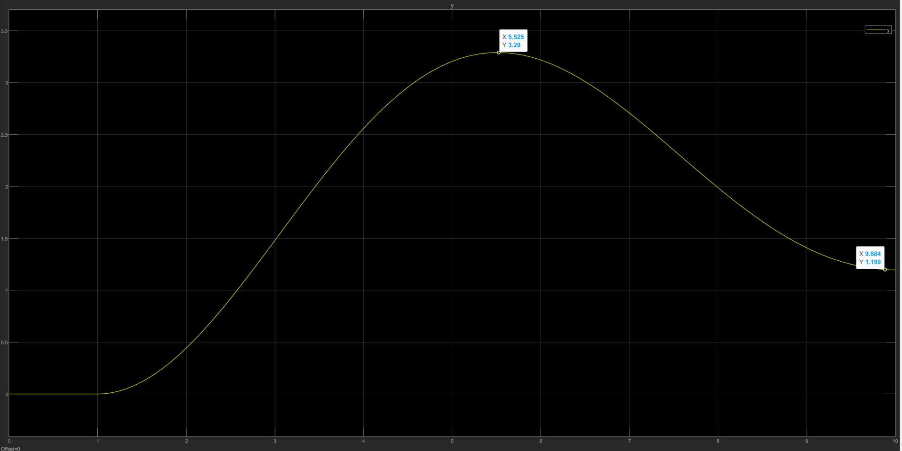
PPC – P1 – System response
Pole = 10 times to the left from open loop pole→
When assigned desired pole →

Slide 5
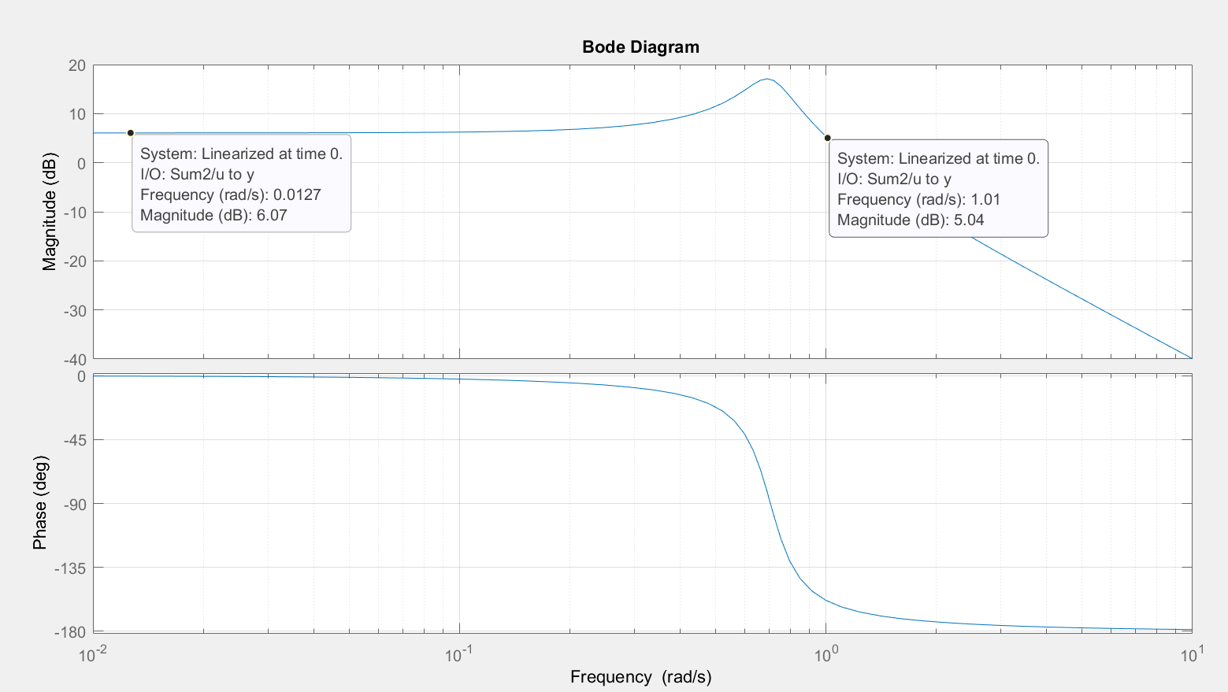
PPC – P1 – Frequency response
With K designed having pole = -.1+0.69805i & -.1-0.69805i

Slide 6
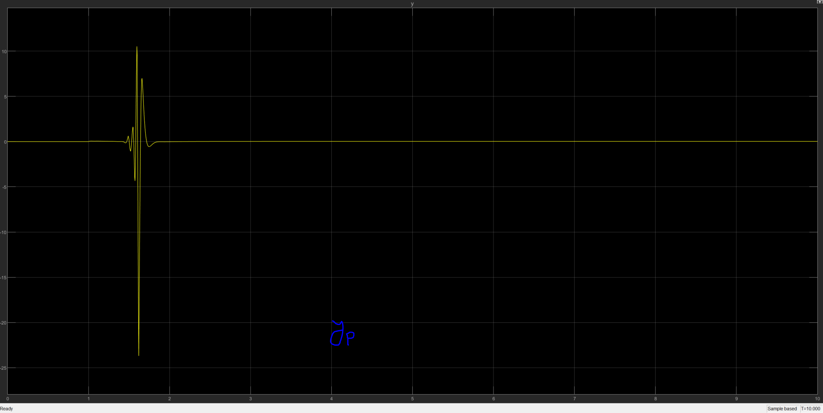
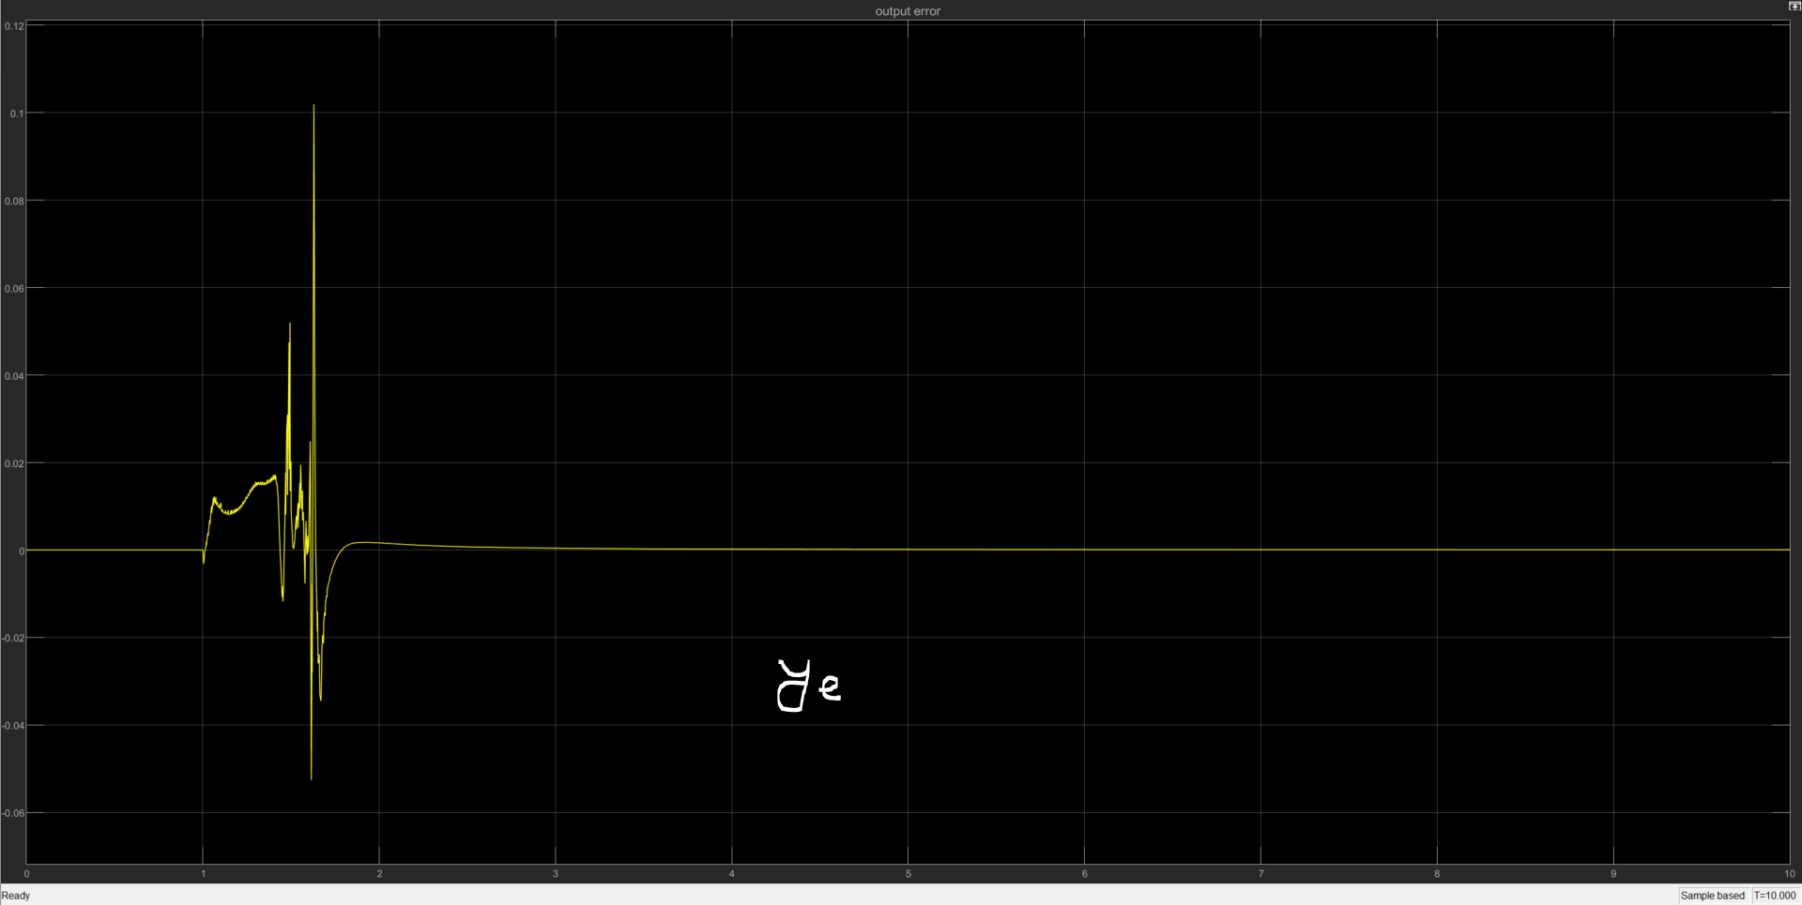
PPC – P2 – System response

Slide 7
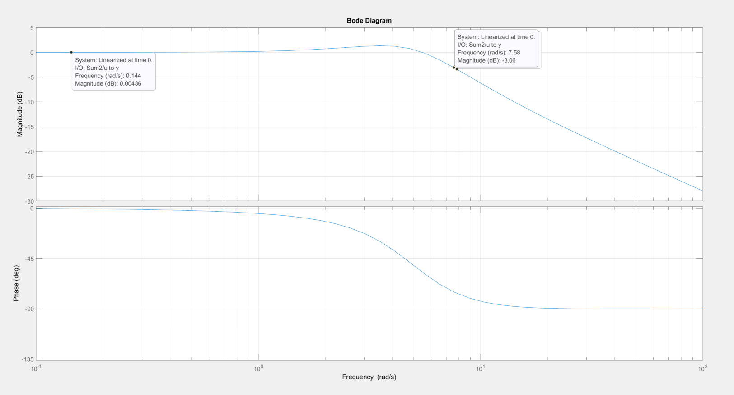
PPC – P2 – Frequency response
Bandwidth of O.L. = 7.5408

Slide 8
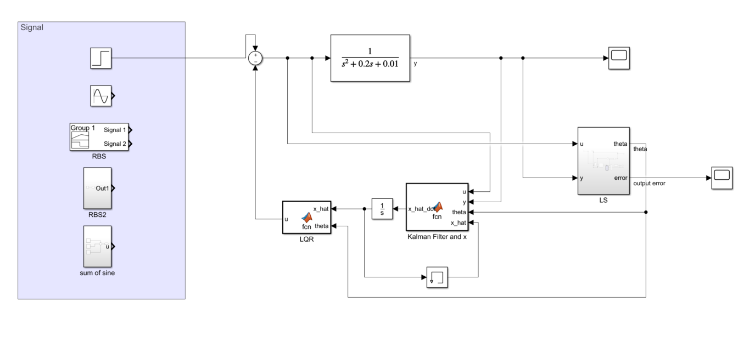
LQG – P1 – system setup
Sampling time: 0.005 s, Q = R = 1 for lqr, Q = R = 0.1 for Kalman.

Slide 9
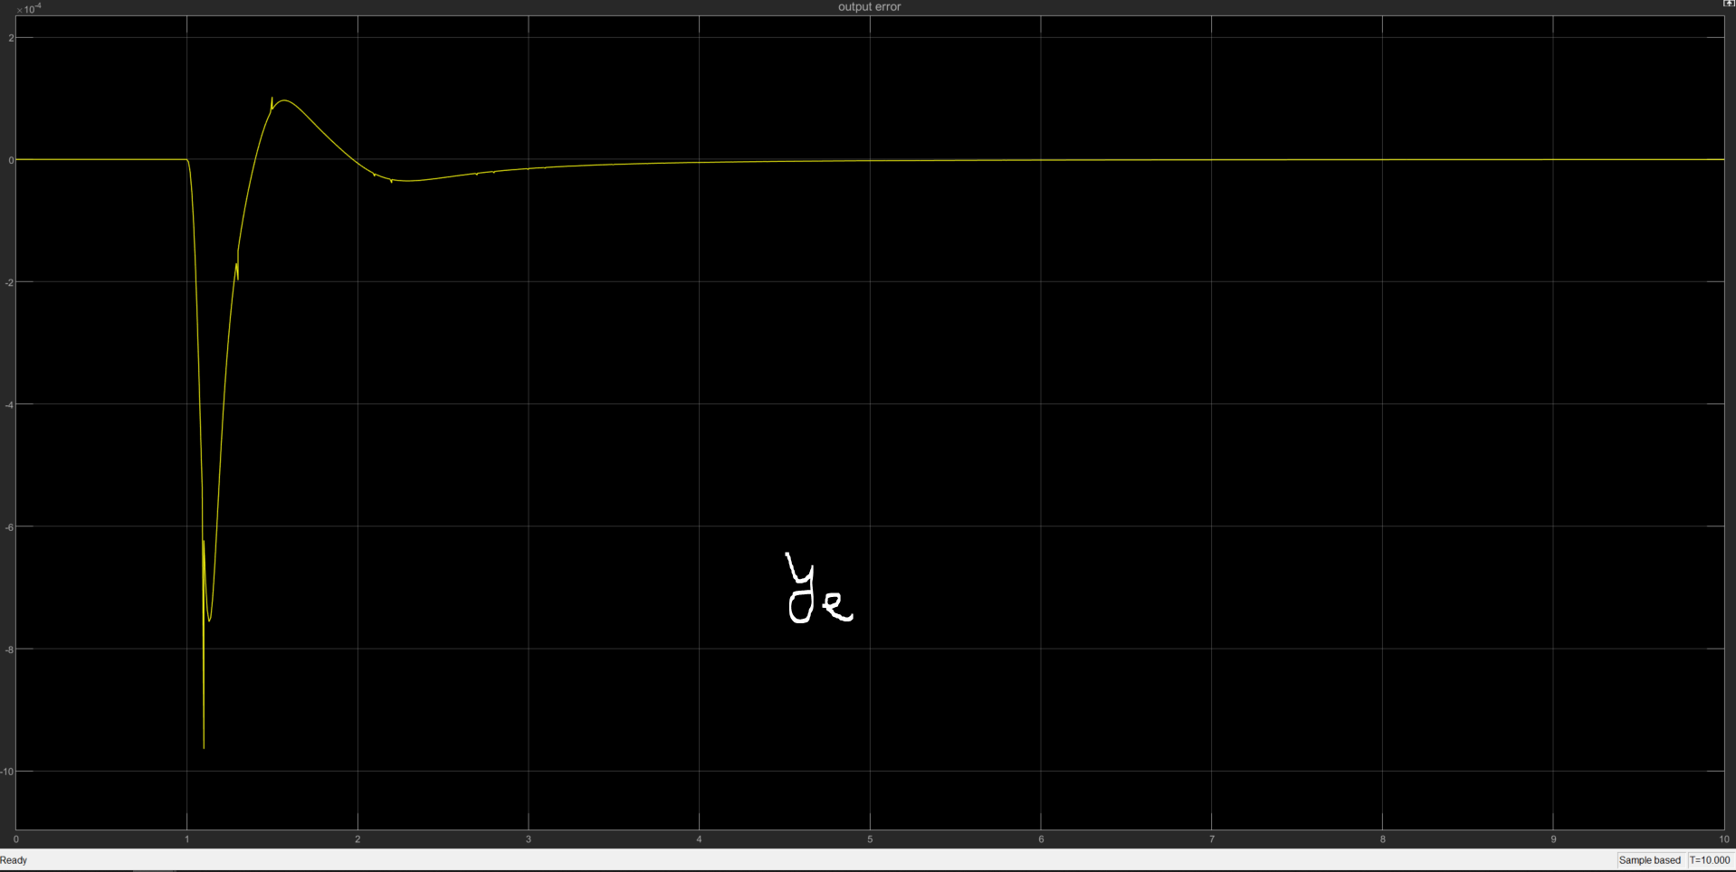
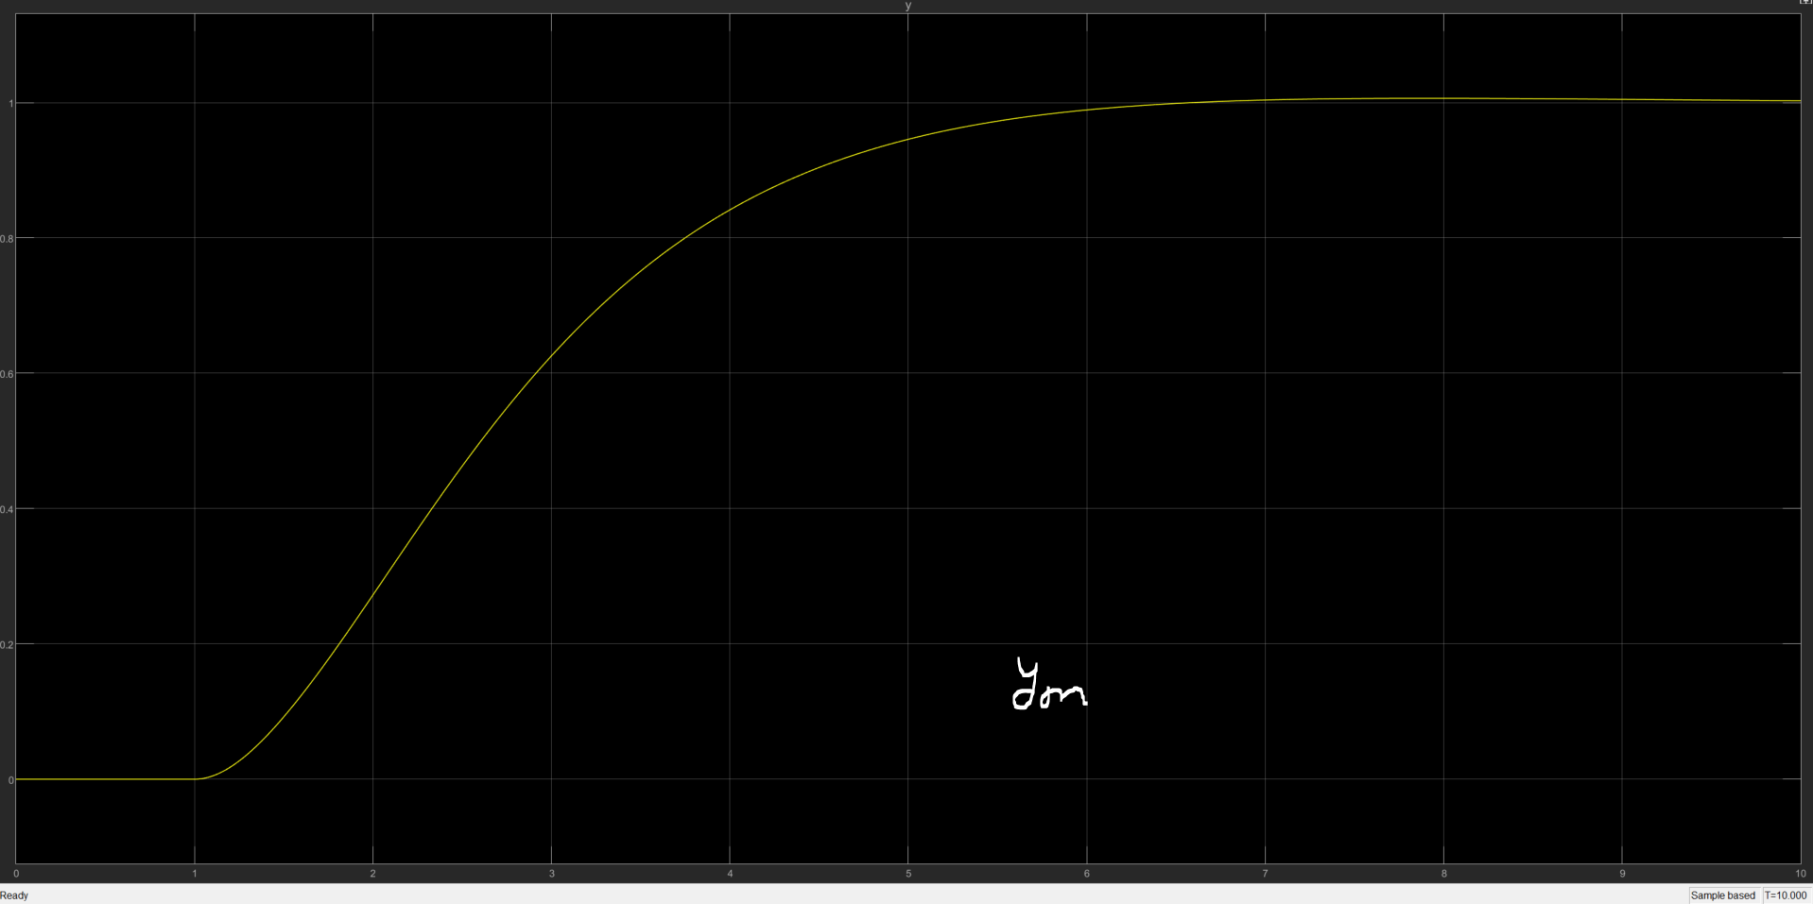
LQG – P1 – system response

Slide 10
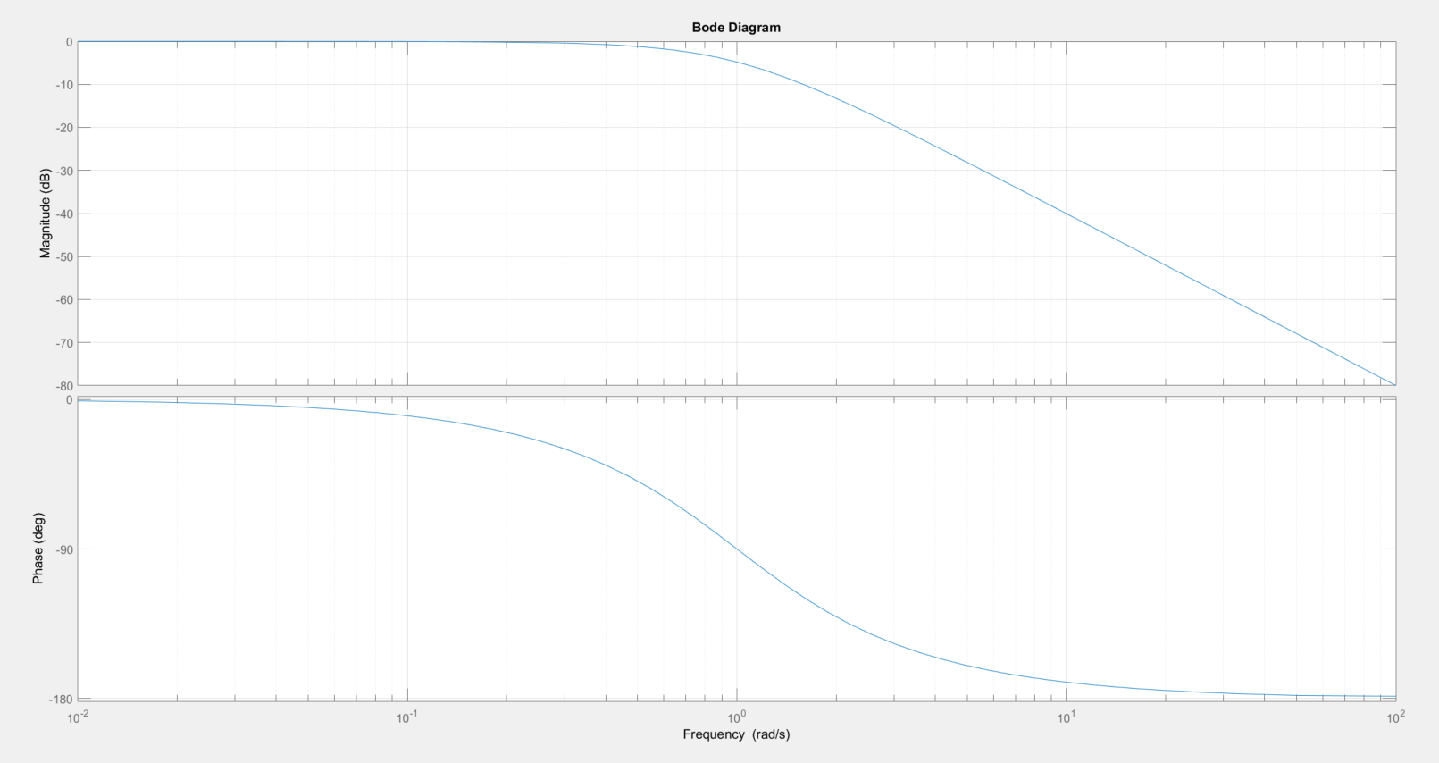
LQG – P1 – Frequency response
Desired bandwidth: 1 rad/s

Slide 11
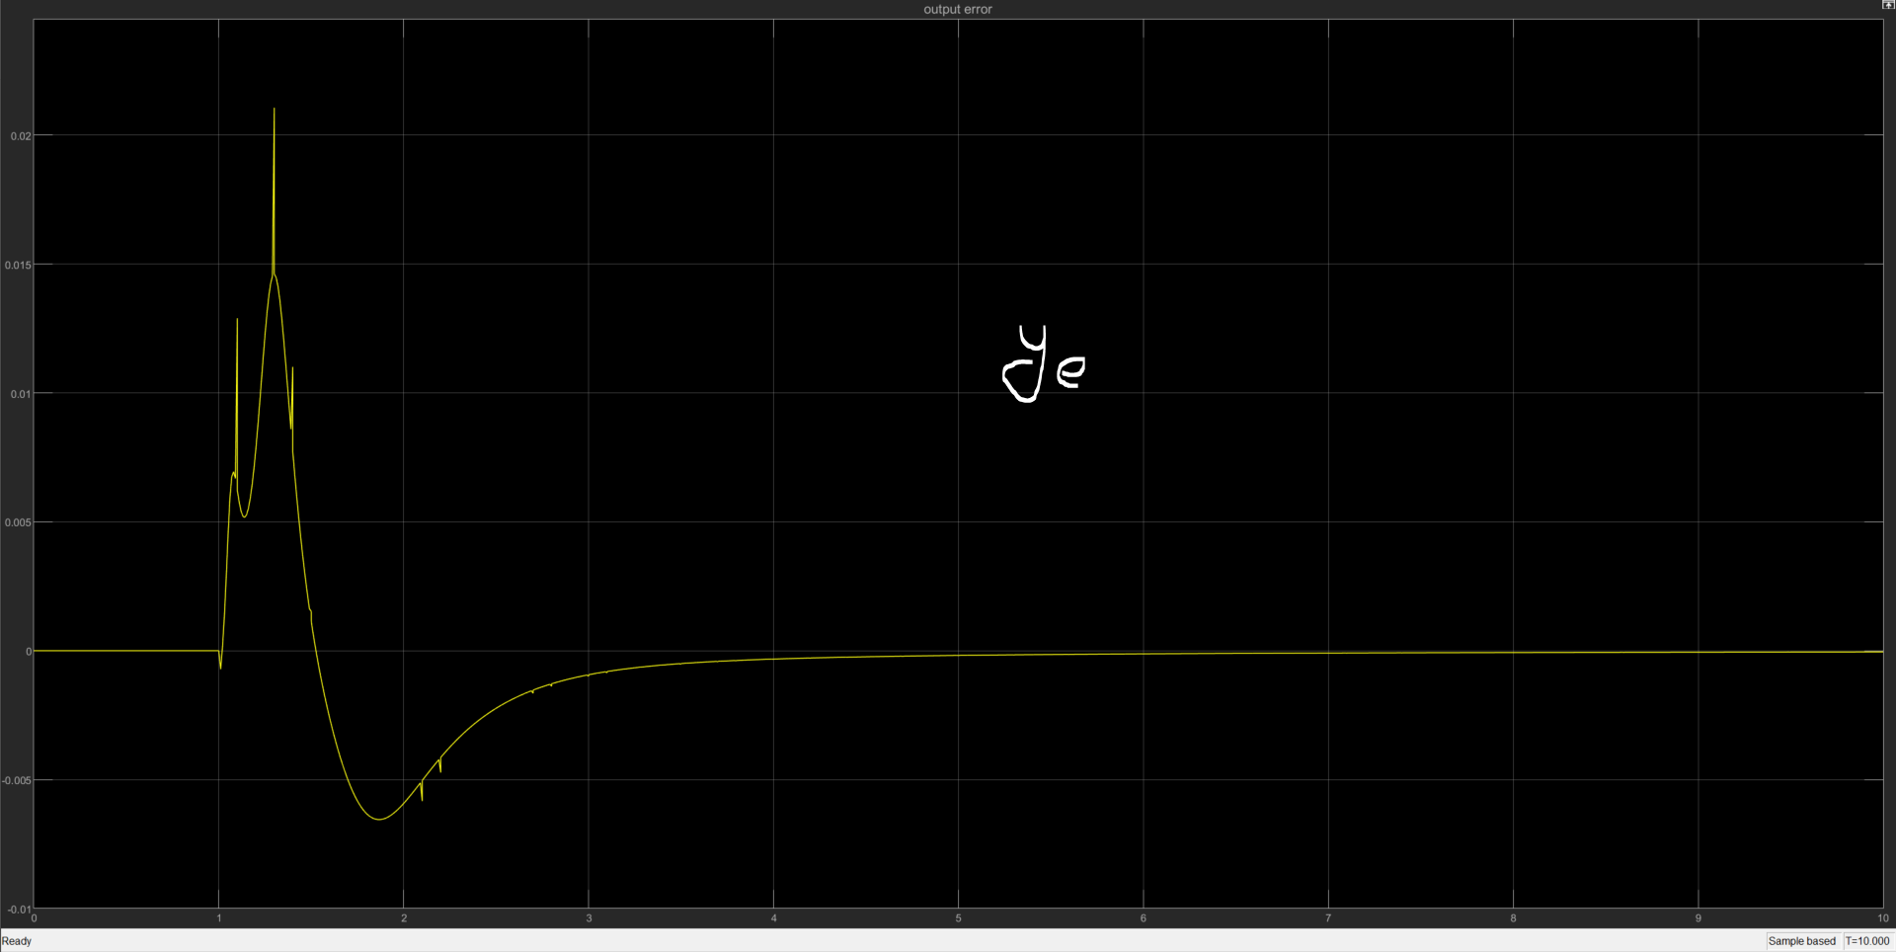
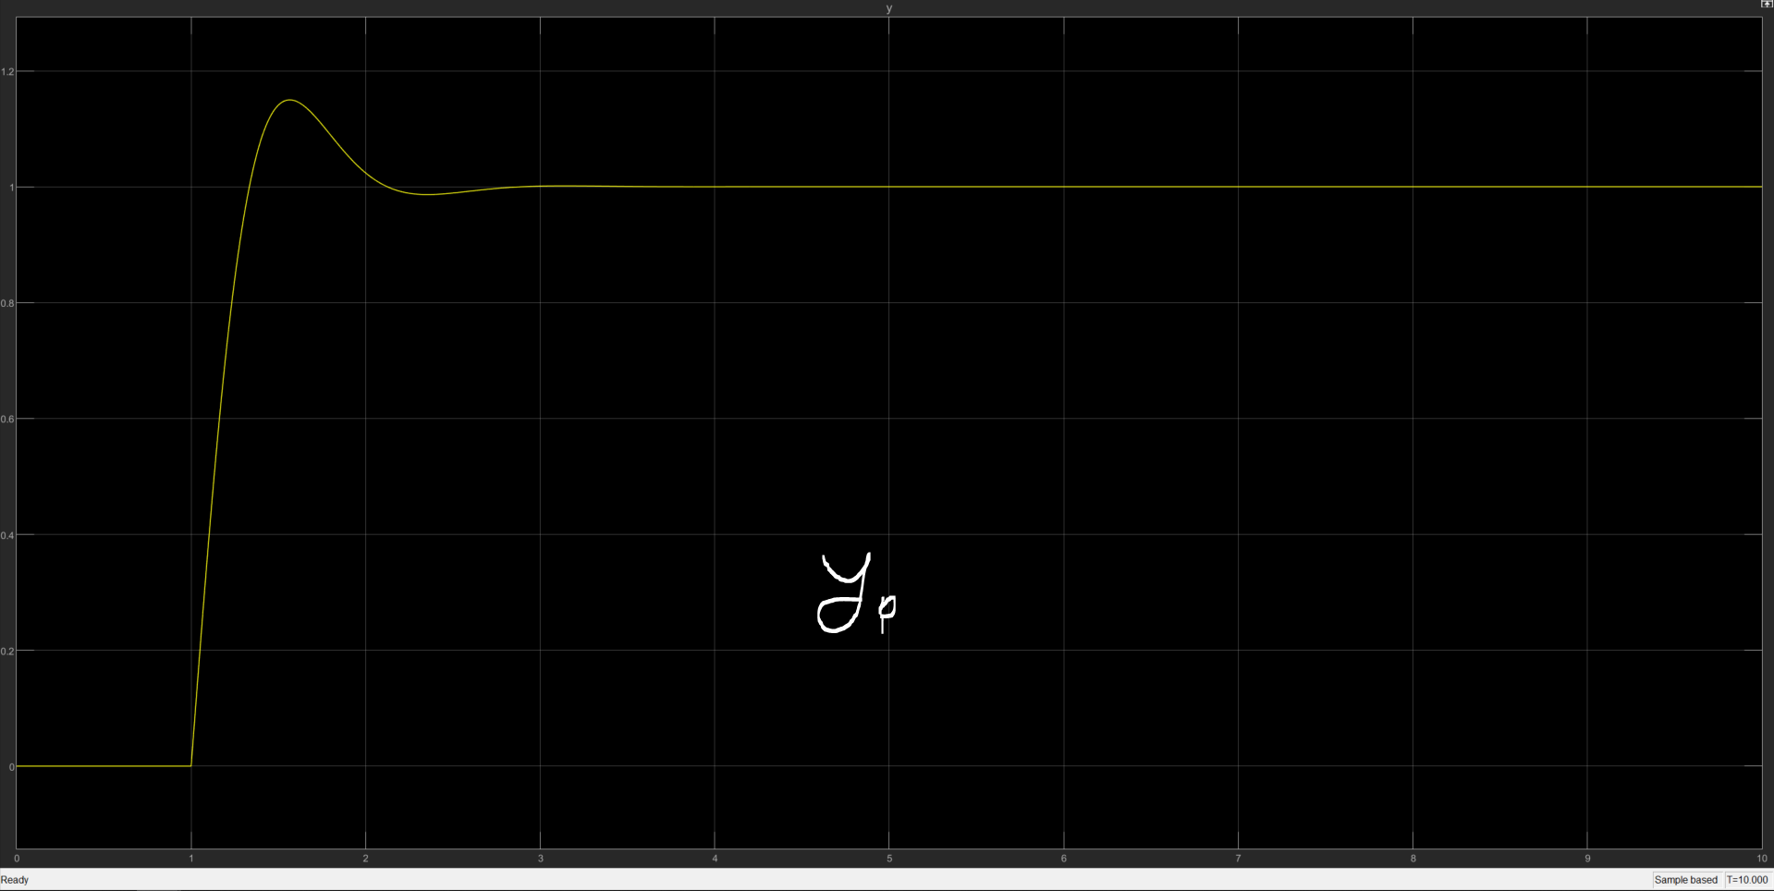
LQG – P2 – system response

Slide 12
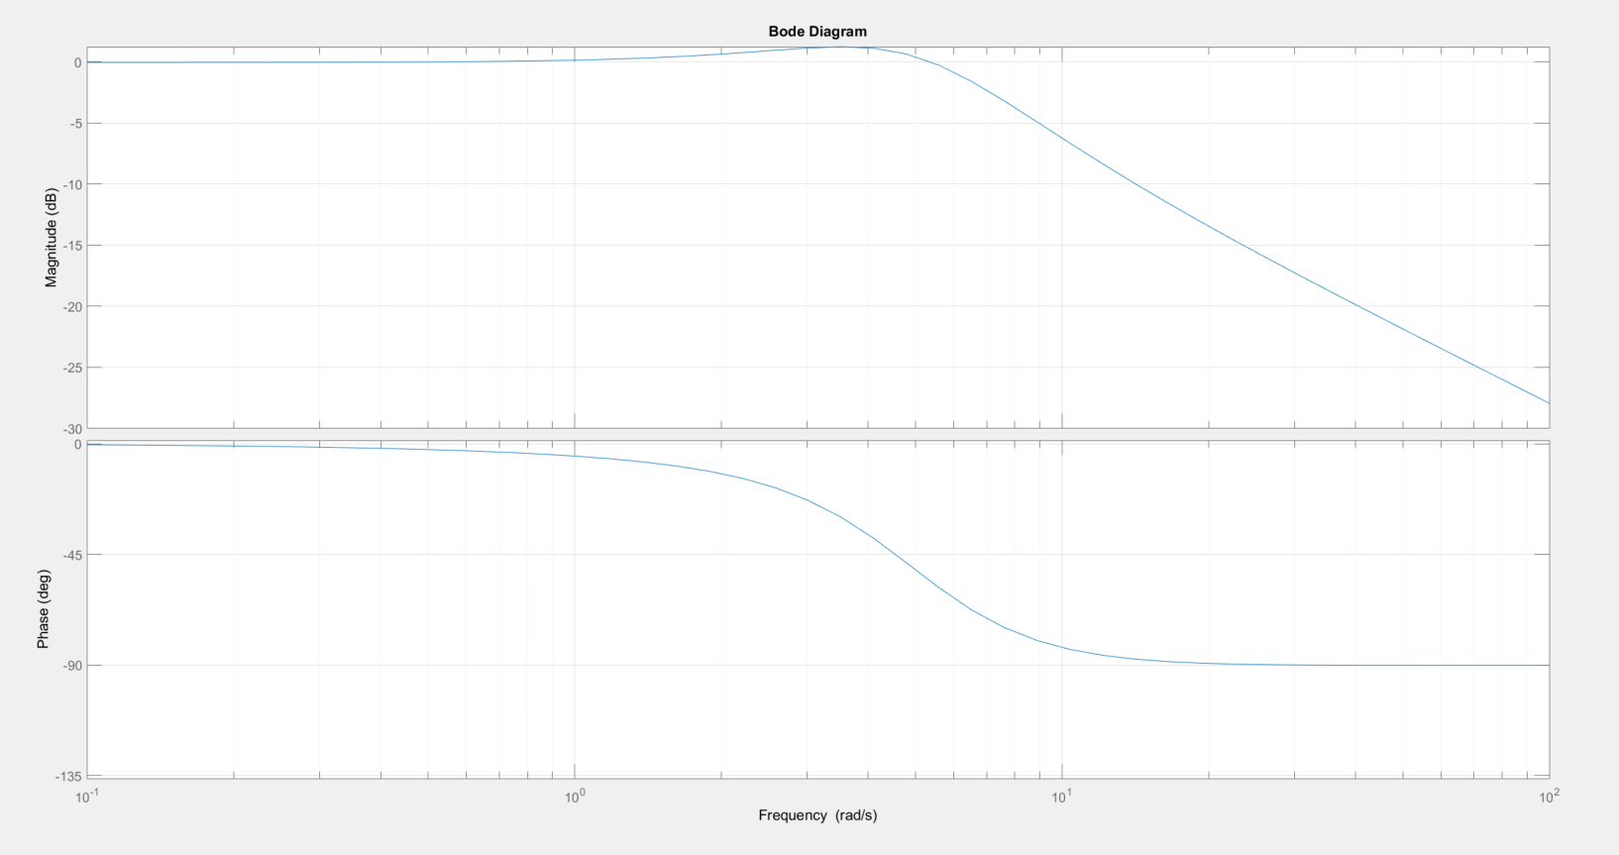
LQG – P2 – Frequency response
Bandwidth of O.L. = 7.5408

Slide 13
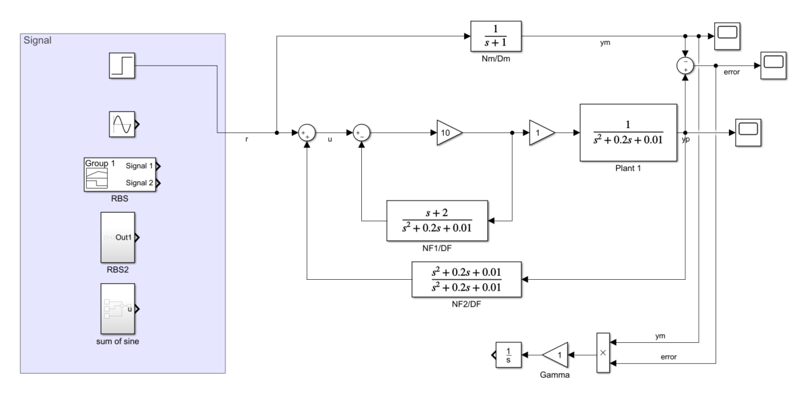
MRC – system setup

Slide 14
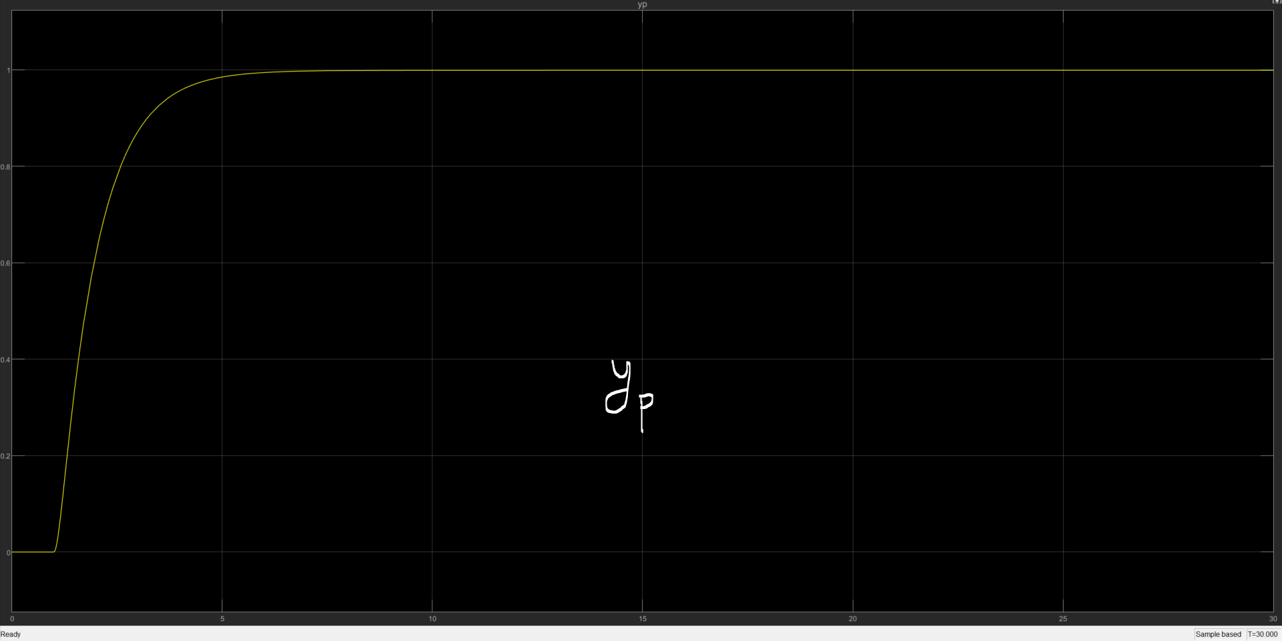
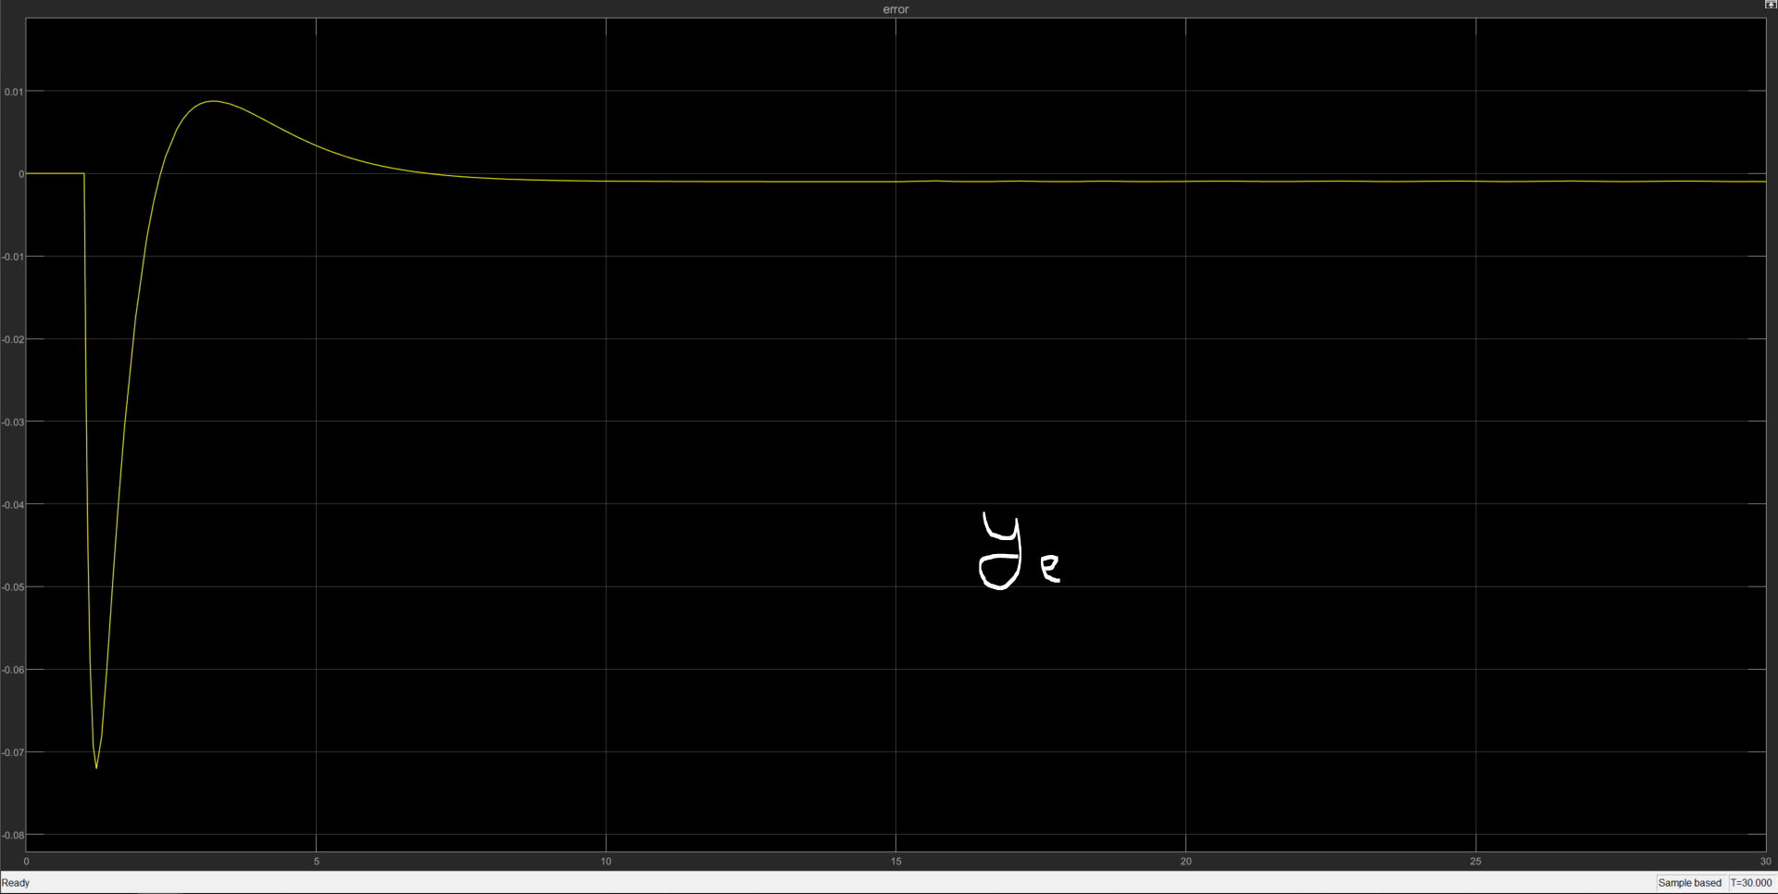
MRC – P1 – System response

Slide 15
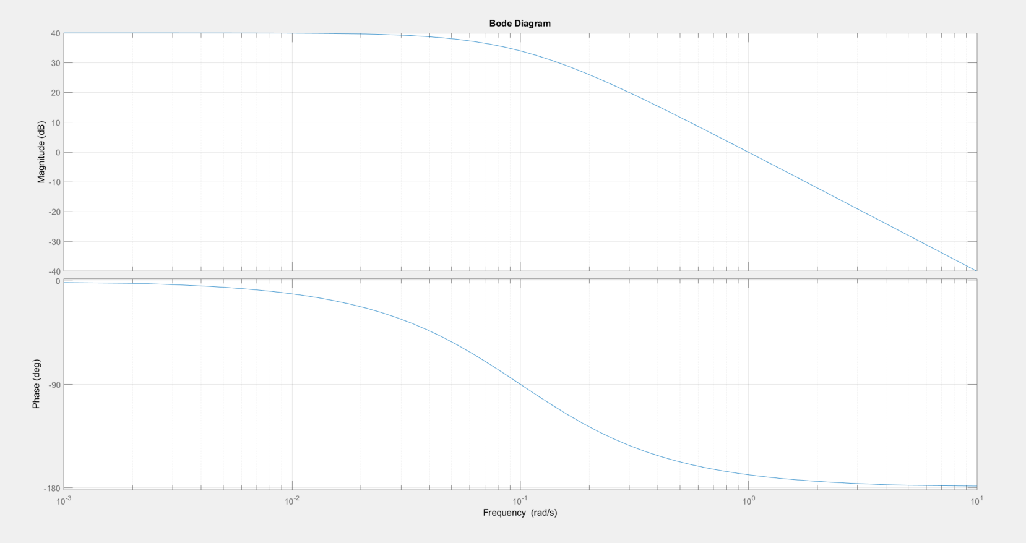
MRC – P1 – Frequency response
Desired bandwidth: 1 rad/s

Slide 16
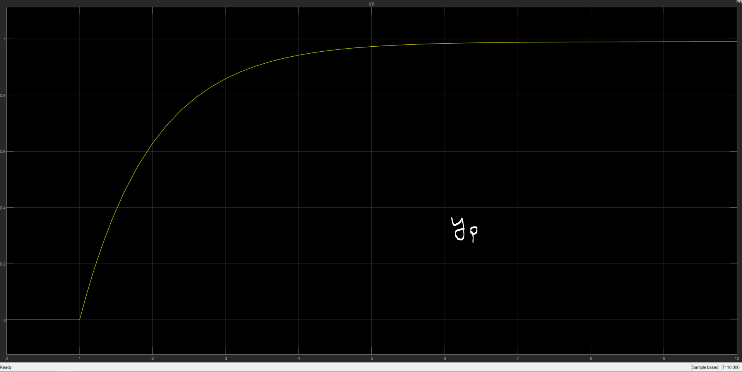
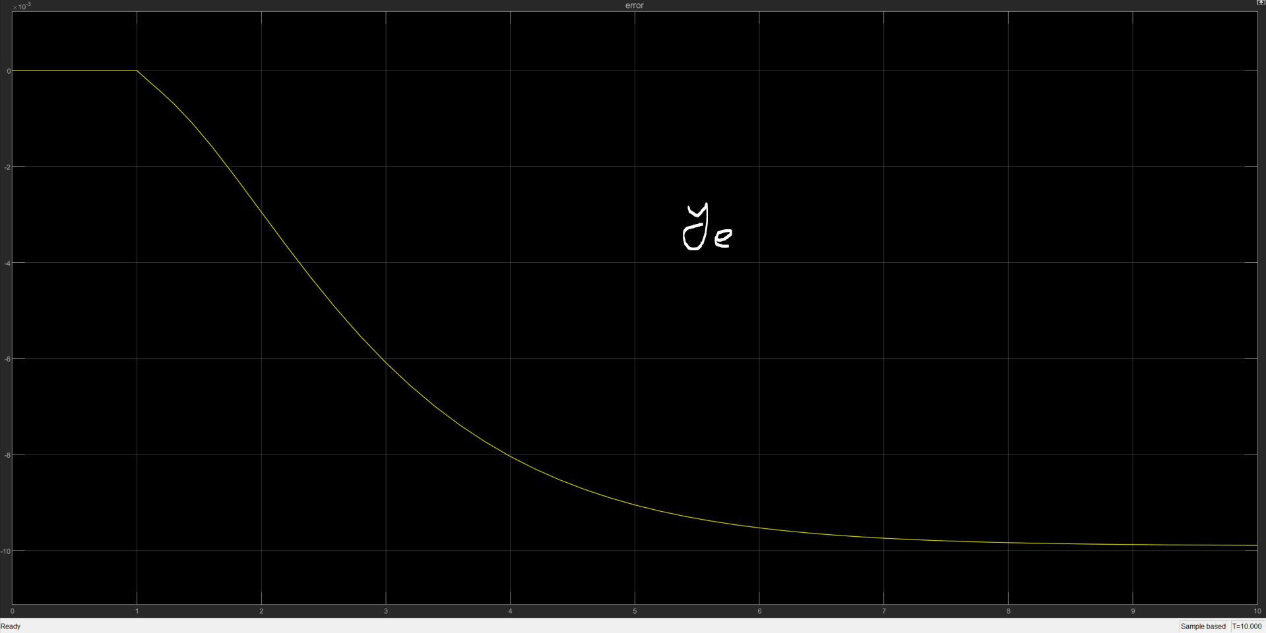
MRC – P2 – System response

Slide 17
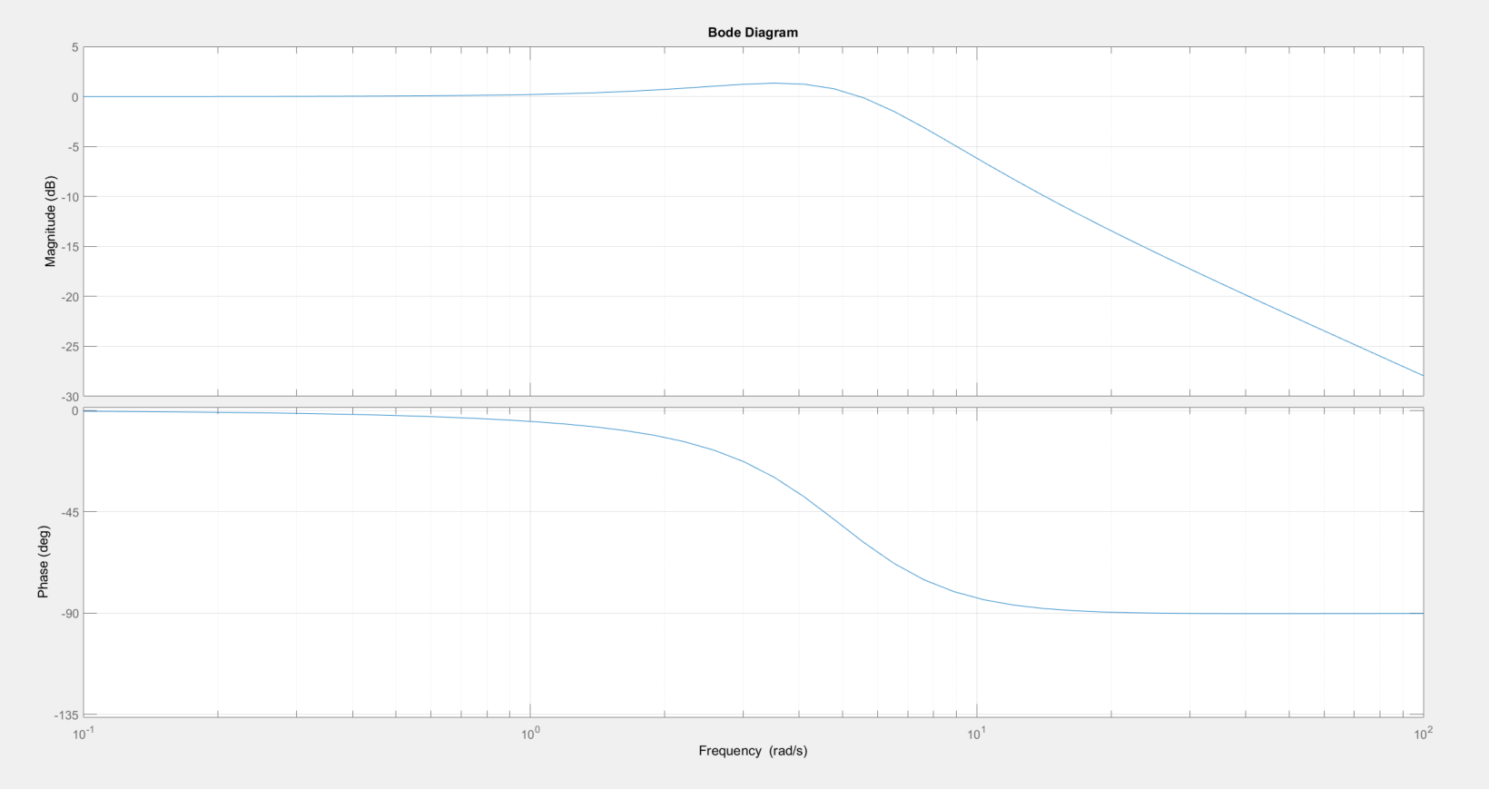
MRC – P2 – Frequency response
Bandwidth of O.L. = 7.5408

Slide 18
Summary
LS parameter convergence is somewhat stable for output, but not for parameters
Real time calculation is starting to get expensive as the time to finish each time step is longer.
PPC is relatively harder to obtain a desired response, since we’d need to calculate the desired pole first for the desired system performance.

